Slide 1
Social Media Behavior and Age
Jushikun Alimasi

Slide 2
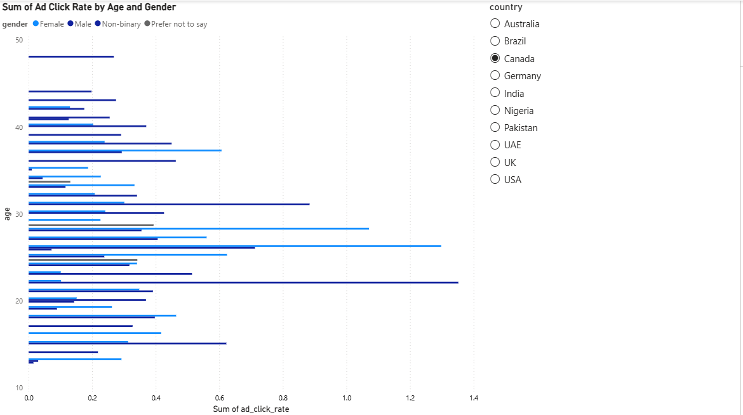
This is showcasing a clustered bar chart which is showing the relationship between ad click rates by age and gender. The slicer
allows me to choose between which countries I want to analyze and the bars show me which gender and age group is more likely
to click on an ad. For this example, it is showing that in Canada, females in their mid 30’s dominate men in terms of ad click rate
while men seem to dominate more in their early 30’s.

Slide 3


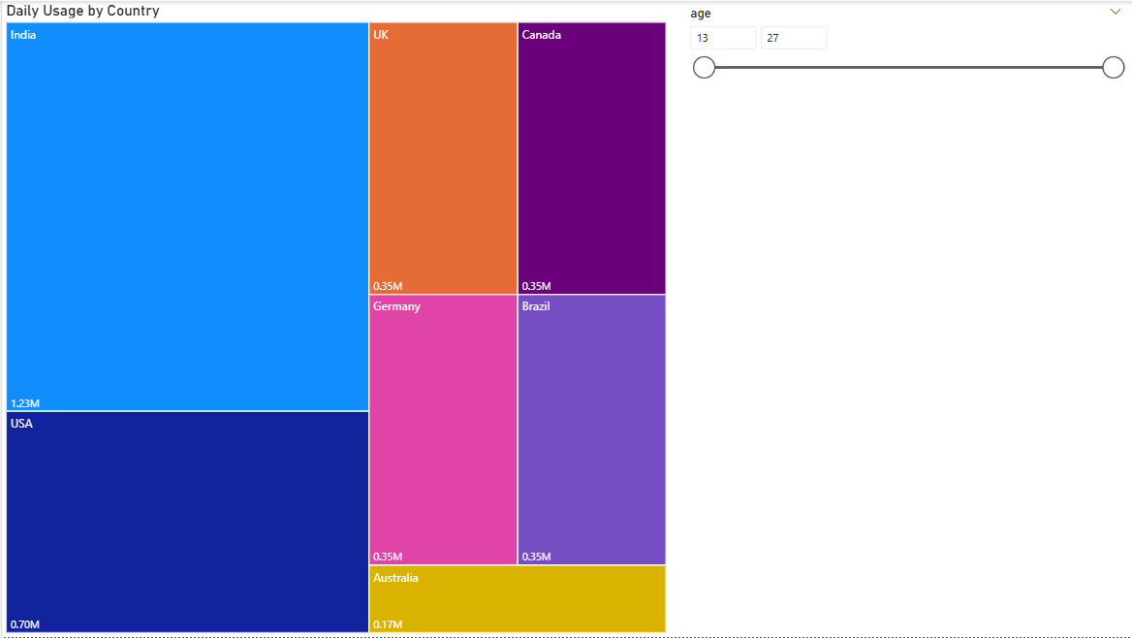

This is a treemap showcasing the sum of daily usage
in hours by country. The slicer to the side lets me filter
between different ages so that I can see what age
group has the higher screen time and what country has
the majority in screen time hours. I chose the treemap
with this slicer because it provides a good representation
on what country engulfs the rest in terms of screen time
and it shows me what age groups are using the most.

Slide 4
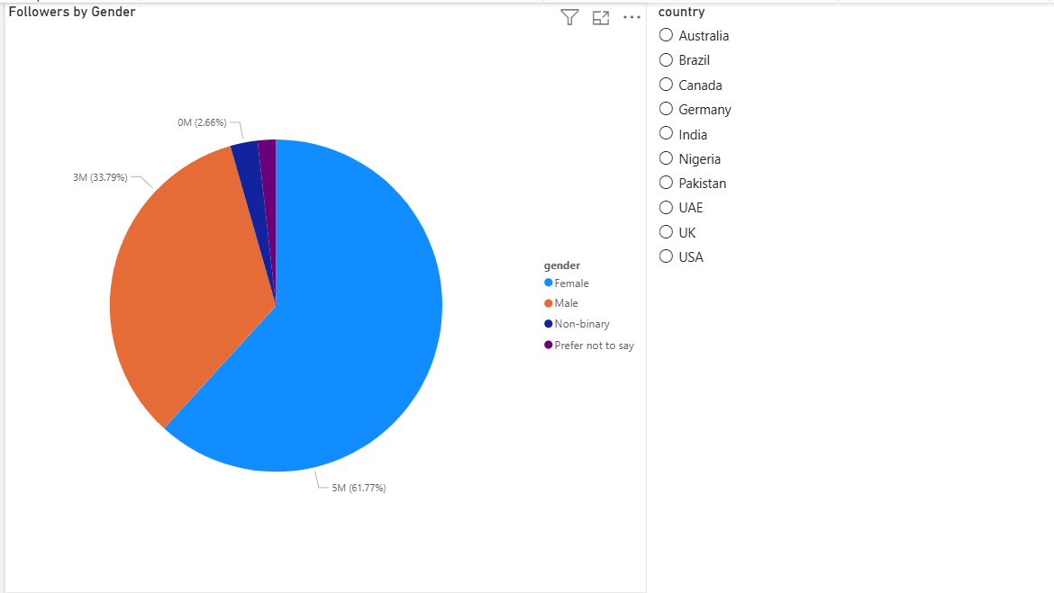
This is a pie chart representing followers by gender. The
slicer on the side filters between different countries. This
pie chart is telling me that on average, females have more
followers than men. But there are cases, for example, USA
where male/others and females have similar follower
counts.

Slide 5
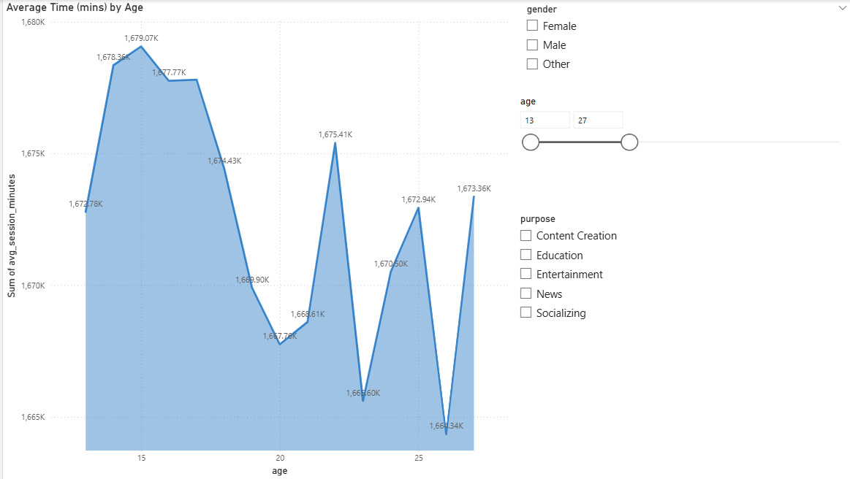
This is a stacked area chart, and it is my main visual. This visual is showcasing the relationship between average session time in minutes and the age of users. The slicers on the right side are there to filter between different age groups, genders, and the purpose of screen usage. I chose this chart because it provides a clean line that showcases how screentime differentiates between different ages. This chart does a good job in telling me what age groups tend to use social media more and where different spikes in usage occur.

Slide 6
Questions answered:
Which age group has the highest usage of social media?
- Using my stacked area chart I can see that the age group from 13-17 make up the highest usage of social media.
Which age group has the highest average session time?
-Again using the stacked area chart I can see that on average, social media usage peaks at the age of 15 and starts dropping off after the age of 17. It also shows me that at the age of 22, social media usage peaks once again.

